Slide 1

Databases. Web Servers and Applications
L(A|E)MP Stack in Action
SoftUni Team
Technical Trainers
Software University
https://softuni.bg

Slide 2
You Have Questions?
sli.do
#LSA-April
facebook.com
/groups/LinuxSystemAdministrationApril2021

Slide 3
Homework Progress
M6 can be submitted
until 23:59:59 on 13.06
M7 can be submitted
until 23:59:59 on 18.06

Slide 4

Previous Module (M6)
Quick Overview

Slide 5
What We Covered
Filesystem Hierarchy Standard (FHS)
Archive and Restore files
Disk drives and Partitions
Filesystems

Slide 6

This Module (M7)
Topics and Lab Infrastructure

Slide 7

Table of Contents
NGINX
LEMP Stack
Web Servers (Apache HTTP)
Relational Databases (MariaDB / MySQL)
Dynamic Web Content Generation (PHP)
Web-based Management Interfaces
LAMP Stack

Slide 8
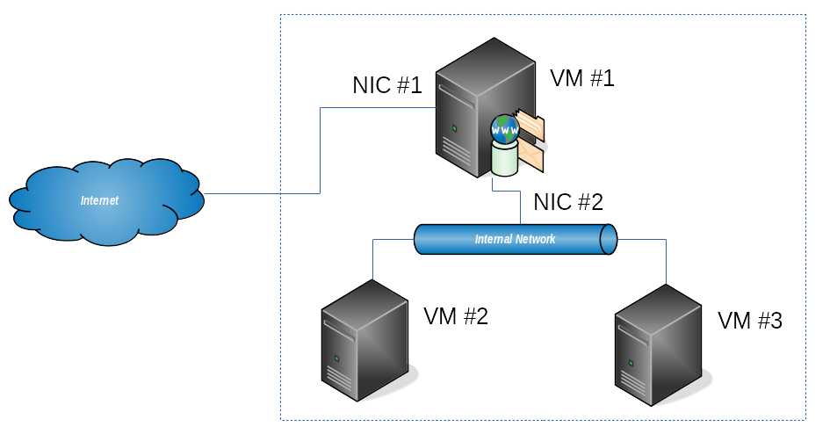
Lab Infrastructure

Slide 9
The End is Near ☺
THIS MODULE
ONE
GO
MORE
AND
TO

Slide 10
Exam is Coming, Prepare Yourself
Test Your Knowledge
https://zahariev.pro/q/lsa-202104

Slide 11
Exam is Coming, Share Are You In ☺
Will You Take Part In The Exam
https://zahariev.pro/q/lsa-exam
* This is NOT an official exam request form

Slide 12

Web Servers
Introduction

Slide 13
Web Servers
Serving web content (static and dynamic) over HTTP/HTTPS
Typical TCP ports 80, 443, 8080, 8443
Typical Web Servers
Apache HTTP
Nginx
lighttpd
standard
used very often

Slide 14
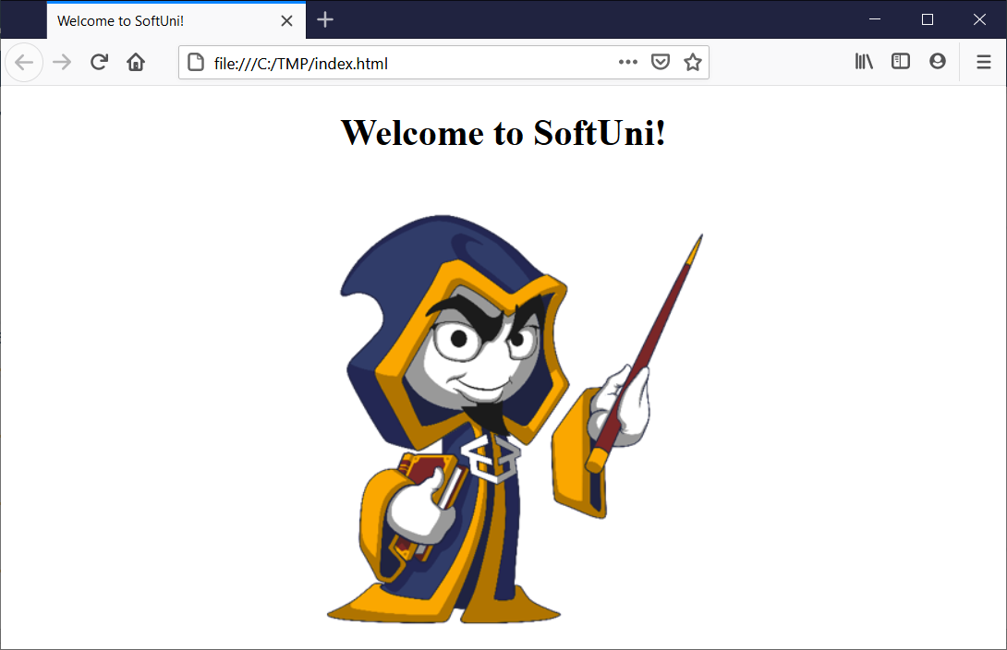


Client – Web Server Communication
HTTP request/response process
Client
Web Server
index.html
Session Request (TCP port 80)
<html>
<head>
<title>Welcome!</title>
</head>
<body>
<div align="center">
<h1>Welcome to SoftUni!</h1>
<img src="wizard.png" />
</div>
</body>
</html>
Session Response
GET Request
Loops
until all
files are
downloaded
GET Response

Slide 15

Apache HTTP Server
Configuration and Tools

Slide 16

Configuration
Configuration root
/etc/httpd
Main configuration
/etc/httpd/conf/*
Additional configuration files
/etc/httpd/conf.d/*.conf
/etc/httpd/conf.modules.d/*.conf

Slide 17

Configuration
Configuration root
/etc/apache2
Main configuration
/etc/apache2/*.conf
Additional configuration files
/etc/apache2/ssl.*/*
/etc/apache2/vhosts.d/*

Slide 18

Configuration
Configuration root
/etc/apache2
Main configuration
/etc/apache2/*.conf
Additional configuration files
/etc/apache2/conf-*/*
/etc/apache2/mods-*/*
/etc/apache2/sites-*/*

Slide 19
Virtual Hosts
Virtual host sample file
/etc/httpd/conf.d/secret.conf
Structure
<VirtualHost *:80>
ServerName "secret.lsa.lab"
DocumentRoot "/var/www/secret"
</VirtualHost>

Slide 20
Log Control
Virtual host sample file
/etc/httpd/conf.d/secret.conf
Structure
<VirtualHost *:80>
ServerName "jupiter.lsa.lab"
DocumentRoot "/var/www/html"
ErrorLog "logs/jupiter_error.log"
CustomLog "logs/jupiter_access.log" common
</VirtualHost>

Slide 21
Access Control by IP
Virtual host sample file
/etc/httpd/conf.d/main.conf
Structure
<VirtualHost *:80>
ServerName "jupiter.lsa.lab"
DocumentRoot "/var/www/html"
<Location />
Require ip 127.0.0.1
</Location>
</VirtualHost>

Slide 22
Access Control by User
Virtual host sample file
/etc/httpd/conf.d/secret.conf
Structure
<VirtualHost *:80>
ServerName "secret.lsa.lab"
DocumentRoot "/var/www/secret"
<Directory "/var/www/secret">
Require valid-user
AuthType Basic
AuthName "Private Access"
AuthBasicProvider file
AuthUserFile "/etc/httpd/conf.d/secret"
</Directory>
</VirtualHost>

Slide 23
apachectl
Purpose
Apache HTTP server control interface
Syntax
Example
apachectl [command]
# Check configuration
apachectl configtest

Slide 24

NGINX
Another Web Server

Slide 25
Configuration
Configuration root
/etc/nginx
Main configuration file
/etc/nginx/nginx.conf
Additional configuration files
/etc/nginx/conf.d/*.conf
Default document root
/usr/share/nginx/html
/srv/www/htdocs
/var/www/html

Slide 26
Practice: Apache HTTP in Action
Live Demonstration in Class

Slide 27

Databases
Comparison. Overview. Objects and Types

Slide 28
Database Types
Database is a container for data
Many classifications
Class - Desktop, Server, Enterprise
Organization - Relational, Object, NoSQL
Purpose - Operational (OLTP), Data warehouses, Analytical (OLAP)
Typical
Relational - MariaDB, MySQL, PostgreSQL, Oracle, MS SQL, …
NoSQL - MongoDB, Cassandra, Redis, Couchbase, …

Slide 29
Architecture
Engines: InnoDB, MyISAM, Others (CSV, MEMORY, …)
Available engines
Client Tools
Server
...
Engine 1
Engine N
File 1
File 1
File N
File N
show engines; # it will list all available engines

Slide 30
Database Files
File Types
.opt - options / settings
.frm - structure
.idb - data and indexes
.myd - data
.mid - indexes
File Location - /var/lib/mysql/
General files
InnoDB
Engine specific files
MyISAM
show variables like 'datadir';

Slide 31
Database Objects
Table
Rows and Columns
Constraints
Indexes
View
Stored logic for reading a data set
Stored Procedures and Functions
Stored code and logic for retrieving or storing data

Slide 32
Data Types
Numeric
Whole - TINYINT, SMALLINT, MEDIUMINT, INT, BIGINT
Fixed - DECIMAL
Floating - FLOAT, DOUBLE
String
CHAR, VARCHAR
TINYTEXT, TEXT, MEDIUMTEXT, LONGTEXT
Date and Time
DATE, TIME, DATETIME, TIMESTAMP
Exact
Numerics

Slide 33

Basic Operations
Basic DCL, DDL, and DML Statements

Slide 34
Statement Types
Data Definition Language (DDL)
Used to create, modify, and delete database objects
Data Manipulation Language (DML)
Used to retrieve, insert, update, and delete data in the database
Data Control Language (DCL)
Used to control access rights
Transaction Control Language (TCL)
Used to control transactions within the database

Slide 35
CREATE (DDL)
Purpose
Create database objects like tables, views, indexes, and others
Syntax
Example
CREATE object_type object_name DEFINITION
# Create a simple table
CREATE TABLE T1 (id INT, person_name VARCHAR(100));
# Create a simple view
CREATE VIEW V1 AS SELECT person_name FROM T1;

Slide 36
DROP (DDL)
Purpose
Remove database objects like tables, views, indexes, and others
Syntax
Example
DROP object_type object_name
# Drop existing table
DROP TABLE T1;
# Drop existing view
DROP VIEW V1;

Slide 37
SELECT (DML)
Purpose
Read a data set from a table or set of tables or views
Syntax
# What?
SELECT list_of_columns
# From where?
FROM table_or_view
# Extend or shrink the data set
[[INNER|LEFT|RIGHT] JOIN table_or_view ON criteria]
# Apply a filter on the data set. For example, by sex, city, …
[WHERE filter]
# Aggregate the data set. For example, by color, size, …
[GROUP BY group_list]
# Sort the result set. For example, by name, weight, …
[ORDER BY order_list]
Required
Optional

Slide 38
INSERT (DML)
Purpose
Add new row(s) to a table
Syntax
Example
INSERT INTO object_name VALUES value_list
# Insert one row of data
INSERT INTO T1(person_name) VALUES ('John');
# Insert two more rows of data
INSERT INTO T1(person_name) VALUES ('Jim'), ('Ed');

Slide 39
DELETE (DML)
Purpose
Delete data from table
Syntax
Example
DELETE FROM object_name [WHERE condition]
# Delete one record
DELETE FROM T1 WHERE person_name='Ed';
# Delete all records from a table
DELETE FROM T1;

Slide 40
UPDATE (DML)
Purpose
Update set of records
Syntax
Example
UPDATE object_name SET field=value [WHERE filter]
# Increase all salaries with 100 units
UPDATE T1 SET salary=salary+100;
# Set bonus for all people with blue eyes to 1000
UPDATE T1 SET bonus=1000 WHERE eyes_color='blue';

Slide 41
JOIN (Part of the SELECT Statement)
Purpose
Link additional data source based on a condition
Syntax
Example
LEFT|INNER|RIGHT JOIN source ON condition
# Join records from two tables
SELECT T1.id, T1.person_name, T2.department_name
FROM T1
LEFT JOIN T2 on T1.did=T2.id;

Slide 42
Combine Data (INNER JOIN)
ID | DID | PERSON_NAME
1 | 10 | Ivan Petrov
2 | 10 | Stoyan Iliev
3 | 20 | Gergana Kostova
4 | 30 | Tsvetanka Petkova
ID | DEPT_NAME
10 | Sales Department
30 | Marketing Department
40 | Accounting Department
T1.ID | T1.DID | T2.DEPT_NAME | T1.PERSON_NAME
1 | 10 | Sales Department | Ivan Petrov
2 | 10 | Sales Department | Stoyan Iliev
4 | 30 | Marketing Department | Tsvetanka Petkova
SELECT T1.ID, T1.DID, T2.DEPT_NAME, T1.PERSON_NAME
FROM PERSONS T1
INNER JOIN DEPARTMENTS T2
ON T2.ID = T1.DID;

Slide 43
Combine Data (LEFT | RIGHT [OUTER] JOIN)
ID | DID | PERSON_NAME
1 | 10 | Ivan Petrov
2 | 10 | Stoyan Iliev
3 | 20 | Gergana Kostova
4 | 30 | Tsvetanka Petkova
ID | DEPT_NAME
10 | Sales Department
30 | Marketing Department
40 | Accounting Department
T1.ID | T1.DID | T2.DEPT_NAME | T1.PERSON_NAME
1 | 10 | Sales Department | Ivan Petrov
2 | 10 | Sales Department | Stoyan Iliev
3 | 20 |  | Gergana Kostova
4 | 30 | Marketing Department | Tsvetanka Petkova
SELECT T1.ID, T1.DID, T2.DEPT_NAME, T1.PERSON_NAME
FROM PERSONS T1
LEFT JOIN DEPARTMENTS T2
ON T2.ID = T1.DID;

Slide 44
GRANT (DCL)
Purpose
Give permissions to a user over an object
Syntax
Example
GRANT privileges ON object TO user
# Create user and grant permissions to a database
GRANT ALL ON DATABASE_1.* TO user@localhost
IDENTIFIED BY 'Password1';
# Apply privileges
FLUSH PRIVILEGES;

Slide 45
REVOKE (DCL)
Purpose
Revoke permissions from a user over an object
Syntax
Example
REVOKE privileges ON object FROM user
# Revoke insert permissions in a database from user
REVOKE INSERT ON DATABASE_1.* FROM user@localhost;
# Apply privileges
FLUSH PRIVILEGES;

Slide 46

Tools
Basic Set of Tools

Slide 47
mysql_secure_installation
Purpose
Post-installation wizard used to secure the installed instance
Syntax
Example
mysql_secure_installation [options]
# Start the wizard
[user@host ~]$ mysql_secure_installation

Slide 48
mysql
Purpose
Client application to communicate with the MariaDB daemon
Syntax
Example
mysql [options]
# Connect to a local MariaDB daemon
[user@host ~]$ mysql -u root -p
# Import database backup
[user@host ~]$ mysql -u root -p db1 < dump.sql

Slide 49
mysqldump
Purpose
Tool for extract / backup a database
Syntax
Example
mysqldump [options]
# Export single database
[user@host ~]$ mysqldump -u root -p sudemo > sudemo.sql
# Export all databases
[user@host ~]$ mysqldump -u root -p --all-databases > exp.sql

Slide 50
Practice: MariaDB in Action
Live Demonstration in Class

Slide 51

Web Content Generation
Types and Tools

Slide 52
Web Content
Different types
Static, Pseudo-dynamic, Dynamic
Different approaches
Client-side, Server-side scripting, or combination
Typical tools / languages
PHP, Perl, Python, Ruby, Java, …

Slide 53

PHP
Introduction to PHP

Slide 54
Introduction to PHP
PHP = PHP: Hypertext Preprocessor
http://php.net
Current versions 7.x / 8.x
Huge repository of libraries / plugins
Many frameworks - Zend, Symfony, Laravel, Yii, Phalcon, …
Supports procedural and object-oriented approach
Can be used as general-purpose scripting language as well

Slide 55
Configuration
Global configuration file
/etc/php.ini
Get settings on command line
Get settings as a web page
php -i
<h1>Current PHP configuration:</h1>
<?php
phpinfo();
?>

Slide 56
Simple PHP Enabled Page
Hello, PHP
<!DOCTYPE HTML>
<html>
<head>
<title>Hello, PHP</title>
</head>
<body>
<?php
echo "Hi, I'm a PHP script!<br>";
echo "Your IP is: ".$_SERVER['REMOTE_ADDR'];
?>
</body>
</html>
http://php.net/manual/en/reserved.variables.server.php

Slide 57
General Rules
PHP code is enclosed in <?php and ?>
A line is terminated with ;
Comments
Single line starts with # or //
Multi line are enclosed in /* and */
Variables
Start with $ followed by a letter or _
Allowed only a-z, A-Z, 0-9, and _
$var1
$1var

Slide 58
if
Purpose
Control the program flow based on a condition
Syntax
Example
if (condition) { on_true } [else {on_false}]
# Check if $var1 equals $var2
if ($var1 == $var2)
echo "var1 and var2 are equal";
else
echo "var1 and var2 are NOT equal";

Slide 59
while
Purpose
Repeat a statement(s) while the condition is true
Syntax
Example
while (condition) { statement }
# Echo numbers from 1 to 5
$var=1;
while ($var <=5) {
echo $var;
$var=$var+1;
}

Slide 60
mysqli_connect
Purpose
Open a new connection to the MySQL server
Syntax
Example
mysqli_connect($host, $user, $pass, $db)
# Check if we can connect
if (mysqli_connect($host, $user, $pass, $db))
echo "Connected!";
else
echo "NOT connected!";

Slide 61
mysqli_query
Purpose
Perform a query on the database
Syntax
Example
mysqli_query($link, $query [, $resultmode])
# Echo do we have data
if (mysqli_query($dbh, $query))
echo "We have data";
else
echo "There is no data";

Slide 62
mysqli_fetch_array
Purpose
Fetch a result row as an associative, a numeric array, or both
Syntax
Example
mysqli_fetch_array($result [, $resulttype])
# Echo every row
while ($row=mysqli_fetch_array($result, MYSQLI_ASSOC)) {
echo "<li>".$row['person_name']."</li>";
}

Slide 63

Web-based Administration
Several Web-based Administration Tools

Slide 64
Introduction
Many options
Different offerings, support options, and capabilities
Cockpit
https://cockpit-project.org
Ajenti
https://ajenti.org/
Webmin
https://webmin.com
Control Web Panel (ex-CentOS Web Panel or CWP)
https://control-webpanel.com/

Slide 65
Practice: PHP. Web Admin Tools
Live Demonstration in Class

Slide 66
Summary
Apache and NGINX are two of the most popular web servers
Together Linux, Apache, MariaDB, and PHP form the LAMP stack
M in the LAMP acronym could stand either for MySQL or MariaDB
MariaDB is compatible with MySQL and both are relational databases

Slide 67
Summary
PHP is one of the many available languages for dynamic web content
PHP can be used in the terminal as a regular scripting language
We can ease our administration duties with tools like Cockpit, Webmin, and etc.

Slide 68
Resources
Apache HTTP Server Documentation
https://httpd.apache.org/docs/
PHP Documentation
http://php.net/docs.php
MariaDB Library
https://mariadb.com/kb/en/library/

Slide 69
Questions?
Notes:
69

Slide 70











SoftUni Diamond Partners

Slide 71



Educational Partners

Slide 72

License
This course (slides, examples, demos, exercises, homework, documents, videos and other assets) is copyrighted content
Unauthorized copy, reproduction or use is illegal
© SoftUni – https://about.softuni.bg/
© Software University – https://softuni.bg
Notes:
72

Slide 73
Trainings @ Software University (SoftUni)
Software University – High-Quality Education, Profession and Job for Software Developers
softuni.bg, about.softuni.bg
Software University Foundation
softuni.foundation
Software University @ Facebook
facebook.com/SoftwareUniversity
Software University Forums
forum.softuni.bg
Notes:
73

